Slide 1

Leverages
(Unit II)
Dr.M.Velavan
Faculty
School of Management
SASTRA Deemed University
Thanjavur – 613 401

Slide 2
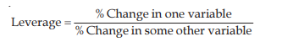
1. Introduction:
The concept of leverage has its origin in science. It means influence of one force over another. Since financial items are inter-related, change in one, causes change in profit. In the context of financial management, the term ‘leverage’ means sensitiveness of one financial variable to change in another. The measure of this sensitiveness is expressed as a ratio and is called degree of leverage.
Algebraically, the leverage may be defined as,

Slide 3
2. Meaning of Leverage:
The term leverage refers to an increased means of accomplishing some purpose. Leverage is used to lift heavy objects, which may not be otherwise possible. From a financial point of view, leverage refers to furnishing the ability to use fixed-cost assets or funds to increase the return to its shareholders.
3. Definition of Leverage:
James Horne has defined leverage as, “the employment of an asset or fund for which the firm pays a fixed cost or fixed return.
Thus according to him leverage results as a result of the firm employing an assets or source of funds which has a fixed cost (or return). The former may be termed as “fixed operating cost” while the latter may be termed as “ fixed financial cost.

Slide 4
4. Concept of leverage:
Profitability
of the firm
Leverage = Lifting heavy object, which may not be otherwise possible
Heavy object
Fixed operating cost
Fulcrum
OL
Fixed overhead cost and Fixed interest securities or funds
[Need to use effectively]
Fixed financial cost
FL

Slide 5
5. Measures of Leverage:
To understand the concept of leverage, it is imperative to understand the three measures of leverage:
(i) Operating Leverage [Business risk]
(ii) Financial Leverage [Financial risk]
(iii) Combined Leverage [Both Business risk and Financial risk]
Business Risk:
It arises due to high amount of fixed overheads in cost structure.
Financial Risk:
It arises due to a high charge of interest due to excessive use of debt components.

Slide 6
(i) Operating Leverage:
Operating leverage reflects the impact of change in sales on the level of operating profits of the firm.
a) The significance of DOL may be interpreted as follows:
Other things remaining constant, higher the DOL, higher will be the change in EBIT for same change in number of units sold in, if firm A has higher DOL than firm B, profits of firm A will increase at faster rate than that of firm B for same increase in demand.
This however works both ways and so losses of firm A will increase at faster rate than that of firm B for same fall in demand. This means higher the DOL, more is the risk.
DOL is high where contribution is high.
There is an unique DOL for each level of output.

Slide 7
Operating Leverage examines the effect of the change in the quantity produced on the EBIT of the Company and is measured by calculating the degree of operating leverage (DOL). The degree of operating leverage is therefore ratio between proportionate change in EBIT and corresponding proportionate change in number of units produced and sold.
It is calculated as follows:
OL = Contribution/EBIT or OP
OP = Operating profit or EBIT
Note:
Operating Leverage = Explain the Operation risk or business risk

Slide 8
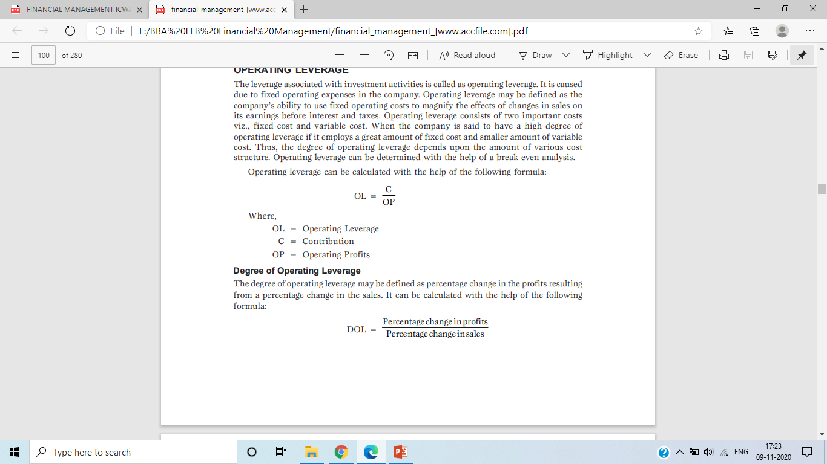
b) Degree of Operating Leverage:
The degree of operating leverage may be defined as percentage change in the profits resulting from a percentage change in the sales. It can be calculated with the help of the following formula:

Slide 9
(ii) Financial Leverage
The Financial leverage may be defined as a % increase in EPS associated with a given percentage increase in the level of EBIT.
Financial leverage emerges as a result of fixed financial charge against the operating profits of the firm. The fixed financial charge appears in case the funds requirement of the firm are partly financed by the debt financing.
By using this relatively cheaper source of finance, in the debt financing, the firm is able to magnify the effect of change in EBIT on the level of EPS.
It is calculated as follows:
FL = EBIT/EBT
Where:
EBIT = Earnings before interest and taxes.
EBT = Earnings before tax

Slide 10
a) The significance of DFL may be interpreted as follows :
Other things remaining constant, higher the DFL, higher will be the change in EPS for same change in EBIT. In other words, if firm K has higher DFL than firm L, EPS of firm K increases at faster rate than that of firm L for same increase in EBIT. However, EPS of firm K falls at a faster rate than that of firm K for same fall in EBIT. This means, higher the DFL more is the risk.
Higher the interest burden, higher is the DFL, which means more a firm borrows more is its risk.
Since DFL depends on interest burden, it indicates risk inherent in a particular capital mix, and hence the name financial leverage.
There is an unique DFL for each amount of EBIT. While operating leverage measures the change in the EBIT of a company to a particular change in the output, the financial leverage measures the effect of the change in EBIT on the EPS of the company.

Slide 11
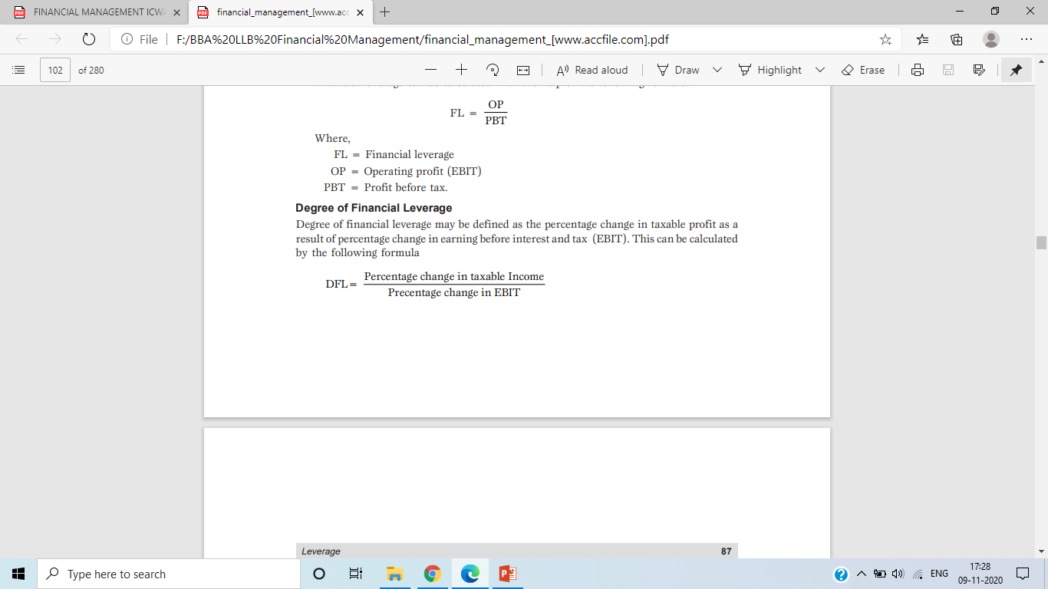
b) Degree of Financial Leverage:
Degree of financial leverage may be defined as the percentage change in taxable profit as a result of percentage change in earning before interest and tax (EBIT). This can be calculated by the following formula:

Slide 12
(iii) Combined Leverage:
The operating leverage explains the business risk of the firm whereas the financial leverage deals with the financial risk of the firm. But a firm has to look into the overall risk or total risk of the firm, which is business risk plus the financial risk.
a) One can draw the following general conclusion about DCL.
Other things remaining constant, higher the DCL, higher will be the change in EPS for same change in Q (Demand).
Higher the DCL, more is the overall risk, and higher the fixed cost and interest burden lower is the earning after interest, and higher is the DCL.
There is an unique DCL, for each level of production and sale .
A combination of the operating and financial leverages is the total or combination leverage.

Slide 13
The operating leverage causes a magnified effect of the change in sales level on the EBIT level and if the financial leverage combined simultaneously, then the change in EBIT will, in turn, have a magnified effect on the EPS. A firm will have wide fluctuations in the EPS for even a small change in the sales level. Thus effect of change in sales level on the EPS is known as combined leverage. It is calculated as follows:
CL = Contribution/EBT or
CL = OL × FL

Slide 14
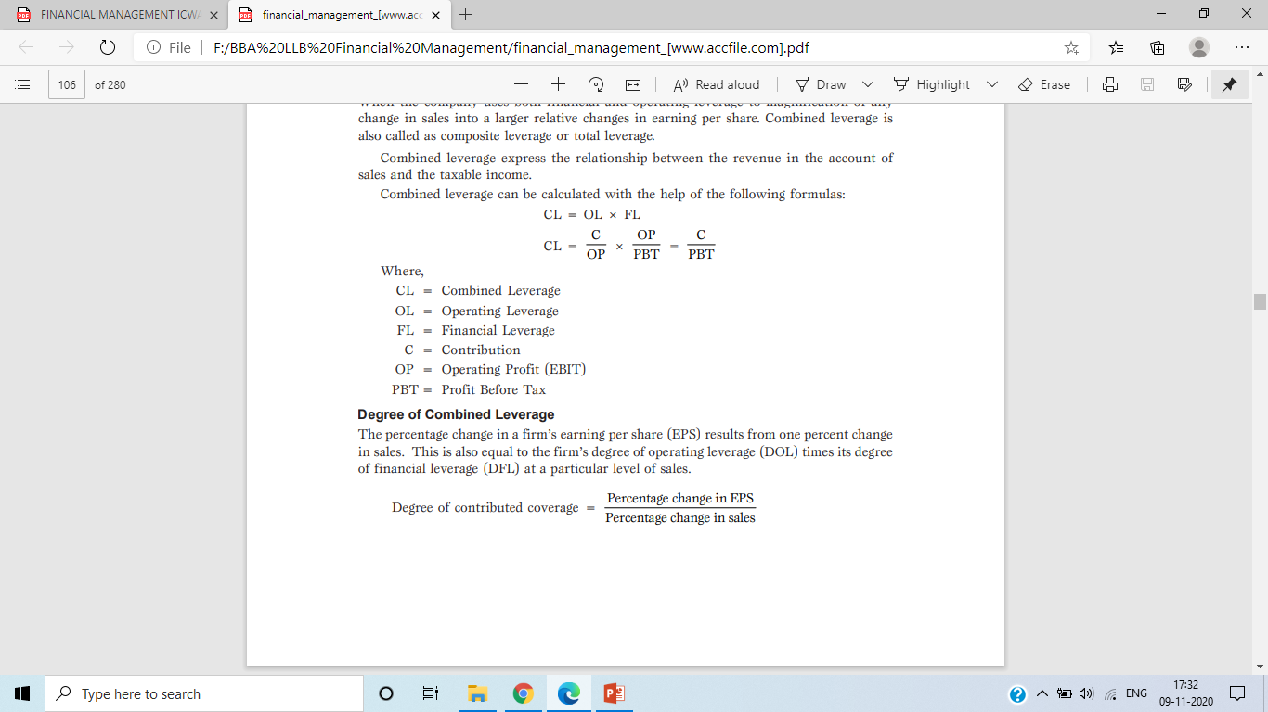
b) Degree of Combined Leverage:
The percentage change in a firm’s earning per share (EPS) results from one percent change in sales. This is also equal to the firm’s degree of operating leverage (DOL) times its degree of financial leverage (DFL) at a particular level of sales.

Slide 15
Statement showing leverages and EPS
 | Particulars | Rs.
 | Sales | ×××
Less | Variable cost | ×××
 | Contribution | ×××
Less | Fixed cost | ×××
 | Earnings before interest and tax [EBIT or OP] | ×××
Less | Interest on debts | ×××
 | Earnings before tax [EBT] | ×××
Less | Income tax | ×××
 | Profit after tax [PAT] | ×××

Slide 16
 | Particulars | Rs.
Less | Preference dividend | ×××
 | Profit available for equity shareholders | ×××
 | Earnings per share [EPS] = Profit for equity shareholders/No of equity shares | ×××
 | Operating leverage [OL] = [Contribution/EBIT] | ×××
 | Financial Leverage [FL] = [EBIT/EBT] | ×××
 | Combined Leverage [CL] = [Contribution/EBT] or [OL × FL] | ×××

Slide 17
6. Effect or Conclusion:
The combined effect of different degrees of operating and financial leverage on the firm is explained as follows:
S.No | Operating Leverage | Financial Leverage | Effect/conclusion
1. | High | High | Very risk. High interest outflow, not commensurate with earnings.
2. | High | Low | Sales still unsatisfactory in relation to the fixed costs to be absorbed.
3. | Low | High | Ideal situation for profit maximisation.
4. | Low | Low | Management overcautious

Slide 18
Solved problems:
P1.From the following information find out operating, financial and combined leverages.
Sales Rs. 1,00,000
Variable Cost Rs. 60,000
Fixed Cost Rs. 20,000
Interest Rs. 10,000.

Slide 19
Solution: Statement showing leverages
 | Particulars | Rs.
 | Sales | 1,00,000
Less | Variable cost | 60,000
 | Contribution | 40,000
Less | Fixed cost | 20,000
 | EBIT | 20,000
Less | Interest | 10,000
 | EBT | 10,000
 | Operating leverage = C/EBIT = Rs. 40,000 / Rs. 20,000 | 2 Times
 | Financial leverage = EBIT/EBT = Rs. 20,000 / Rs. 10,000 | 2 Times
 | Combined leverage = C/EBT = Rs. 40,000 / Rs. 10,000 | 4 Times

Slide 20
P2. Arvind Ltd. has the following information. Calculate financial leverage, operating leverage, and combined leverage.
Sales 50,000 units @Rs. 10 each
Variable cost @ Rs. 6 Per Unit
Fixed Cost Rs. 1,00,000
Interest 8% of Rs.5,00,000

Slide 21
Solution: Statement showing leverages
 | Particulars | Rs.
 | Sales [50,000 units @ Rs. 10 each] | 5,00,000
Less | Variable cost @ Rs. 6 per unit [50,000 units × Rs. 6 ] | 3,00,000
 | Contribution | 2,00,000
Less | Fixed cost | 1,00,000
 | EBIT | 1,00,000
Less | Interest @ 8% of Rs. 5,00,000 | 40,000
 | EBT | 60,000
 | Operating leverage = C/EBIT = Rs. 2,00,000 / Rs. 1,00,000 | 2 Times
 | Financial leverage = EBIT/EBT = Rs. 1,00,000 / Rs. 60,000 | 1.67 Times
 | Combined leverage = C/EBT = Rs. 2.00,000 / Rs. 60,000 | 3.33 Times

Slide 22
P3. A company has sales of Rs. 1,00,000. The variable costs are 40% of the sales while the fixed operating costs amount to Rs. 30,000. The amount of interest on long-term debt is Rs. 10,000.
You are required to calculate the composite leverage and illustrate its impact if sales increase by 5%.

Slide 23
Solution: Statement of composite leverage
The combined leverage of 3 times indicates that with every increase of Re.1 in sales, the taxable income will increase by Rs. 3 [i.e., 1×3]
 | Particulars | Rs.
 | Sales | 1,00,000
Less | Variable cost @40% of sales | 40,000
 | Contribution | 60,000
Less | Fixed cost | 30,000
 | EBIT | 30,000
Less | Interest | 10,000
 | EBT | 20,000
 | Combined leverage = C/EBT = Rs. 60,000 / Rs. 20,000 | 3 Times

Slide 24
This can be verified by the following computations when the sales increase by 5%.
It is clear from the above computations that on account of increase in sales by 5% the Profit before tax has increased by 15%. This can verified as follows:
 | Particulars | Rs.
 | Sales [increased by 5%] | 1,05,000
Less | Variable cost @40% of sales | 42,000
 | Contribution | 63,000
Less | Fixed cost | 30,000
 | EBIT | 33,000
Less | Interest | 10,000
 | EBT | 23,000

Slide 25
Increase in percentage of profit:
= [Increase in profit/Base profit]×100
= [Rs. 3,000/Rs.20,000]×100
= 15%

Slide 26
P4. Calculate the degree of operating leverage (DOL), degree of financial leverage (DFL) and the degree of combined leverage (DCL) for the following firms and interpret the results.
 | Particulars | Firm A | Firm B | Firm C
1. | Output (Units) | 60,000 | 15,000 | 1,00,000
2. | Fixed costs (Rs.) | 7,000 | 14,000 | 1,500
3. | Variable cost per unit (Rs.) | 0.20 | 1.50 | 0.02
4. | Interest on borrowed funds (Rs.) | 4,000 | 8,000 | Nil
5. | Selling price per unit (Rs.) | 0.60 | 5.00 | 0.10

Slide 27
Solution: Statement showing leverages
 | Particulars | Firm A Rs. | Firm B Rs. | Firm C Rs.
 | Sales [Units × Selling price per unit] | 36,000 | 75,000 | 10,000
Less | Variable cost [Units × V.C per unit] | 12,000 | 22,500 | 2,000
 | Contribution | 24,000 | 52,500 | 8,000
Less | Fixed cost | 7,000 | 14,000 | 1,500
 | EBIT | 17,000 | 38,500 | 6,500
Less | Interest | 4,000 | 8,000 | Nil
 | EBT | 13,000 | 30,500 | 6,500
1. | Operating leverage = C/EBIT | 1.41 Times | 1.38 Times | 1.23 Times
2. | Financial leverage = EBIT/EBT | 1.31 Times | 1.26 Times | 1.00Times
3. | Combined leverage = C/EBT | 1.85 Times | 1.72 Times | 1.23 Times

Slide 28
Interpretation:
High operating leverage combined with high financial leverage represents risky situation.
Low operating leverage combined with high financial leverage will constitute an ideal situation.
Therefore, firm M is less risky because it has low fixed cost and low interest and consequently low combined leverage.

Slide 29
P5. A firm has sales of Rs. 10,00,000, variable cost of Rs. 7,00,000 and fixed costs of Rs. 2,00,000 and debt of Rs. 5,00,000 at 10% rate of interest. What are the operating, financial and combined leverages? If the firm wants to double its Earnings before interest and tax (EBIT), how much of a rise in sales would be needed on a percentage basis?

Slide 30
Solution: Statement showing leverages
 | Particulars | Rs.
 | Sales | 10,00,000
Less | Variable Cost [70% of sales] | 7,00,000
 | Contribution | 3,00,000
Less | Fixed Cost | 2,00,000
 | EBIT | 1,00,000
Less | Interest @ 10% on 5,00,000 | 50,000
 | EBT | 50,000
 | Operating Leverage = Contribution /EBIT = 3 Lakh/1 Lakh | 3 Times
 | Financial Leverage = EBIT/EBT = 1,00,000/50,000 | 2 Times
 | Combined leverage = Contribution/EBT = 3,00,000/50,000 | 6 times

Slide 31
Statement of Sales needed to Double the EBIT:
Operating leverage is 3 times i.e., 33-1/3% increase in sales volume cause a 100% increase in operating profit or EBIT. Thus, at the sales of Rs. 13,33,333, operating profit or EBIT will become Rs. 2,00,000 i.e., double the existing one.
Verification:
 | Particulars | Rs.
 | Sales[Rs. 10,00,000 +1/3 of Rs. 10,00,000] | 13,33,333
Less | Variable Cost [70% of sales} | 9,33,333
 | Contribution | 4,00,000
Less | Fixed Cost | 2,00,000
 | EBIT | 2,00,000

Slide 32
P6. X Corporation has estimated that for a new product its break-even point is 2,000 units if the items are sold for Rs. 14 per unit; the cost accounting department has currently identified variable cost of Rs. 9 per unit. Calculate the degree of operating leverage for sales volume of 2,500 units and 3,000 units. What do you infer from the degree of operating leverage at the sales volumes of 2,500 units and 3,000 units and their difference if any?

Slide 33
Solution: Statement showing leverages
 | Particulars | 2,500 Units Rs. | 3,000 Units Rs.
 | Sales @ Rs. 14 per unit | 35,000 | 42,000
Less | Variable Cost @ Rs. 9 per unit | 22,500 | 27,000
 | Contribution | 12,500 | 15,000
Less | Fixed Cost [2,000 units × [Rs. 14 – Rs.9] | 10,000 | 10,000
 | EBIT | 2,500 | 5,000
 | Operating Leverage = Contribution /EBIT | 5 Times | 3 Times

Slide 34
Conclusion:
At the sales volume of 3,000 units, the operating profit is Rs. 5,000 which is double the operating profit of Rs. 2,500 (sales volume of 2,500 units) because of the fact that the operating leverage is 5 times at the sales volume of 2,500 units. Hence increase of 20% in sales volume, the operating profit has increased by 100% i.e., 5 times of 20%. At the level of 3,000 units, the operating leverage is 3 times. If there is change in sales from the level of 3,000 units, the % increase in EBIT would be three times that of % increase in sales volume.

Slide 35
P7. The Capital Structure of the Progressive Corporation Limited consist of an ordinary share capital of Rs. 10,00,000 (shares of Rs. 100 per share value) and Rs. 10,00,000 of 10% debentures. Sales increased by 20% from 1,00,000 units to 1,20,000 units, the selling price Rs. 10 per unit, variable cost amounts to Rs. 6 per unit and fixed expenses amount to Rs. 2,00,000. The income tax rate is assumed to be 50 per cent.
You are required to calculate the following:
The percentage of increase in earnings per share.
The degree of financial leverage at 1,00,000 units and 1,20,000 units.
The degree of operating leverage at 1,00,000 units and 1,20,000 units.
Comment on the behaviour of operating and financial leverages in relation to increase in production from 1,00,000 units to 1,20,000 units.

Slide 36
Solution:
Statement showing EPS and Leverages
 | Particulars | 1,00,000 Units | 1,20,000 Units
 | Sales [Rs. 10 per unit] | 10,00,000 | 12,00,000
Less | Variable Cost | 6,00,000 | 7,20,000
 | Contribution | 4,00,000 | 4,80,000
Less | Fixed Expenses | 2,00,000 | 2,00,000
 | EBIT | 2,00,000 | 2,80,000
Less | Interest | 1,00,000 | 1,00,000
 | EBT | 1,00,000 | 1,80,000
Less | Tax @50% | 50,000 | 90,000

Slide 37
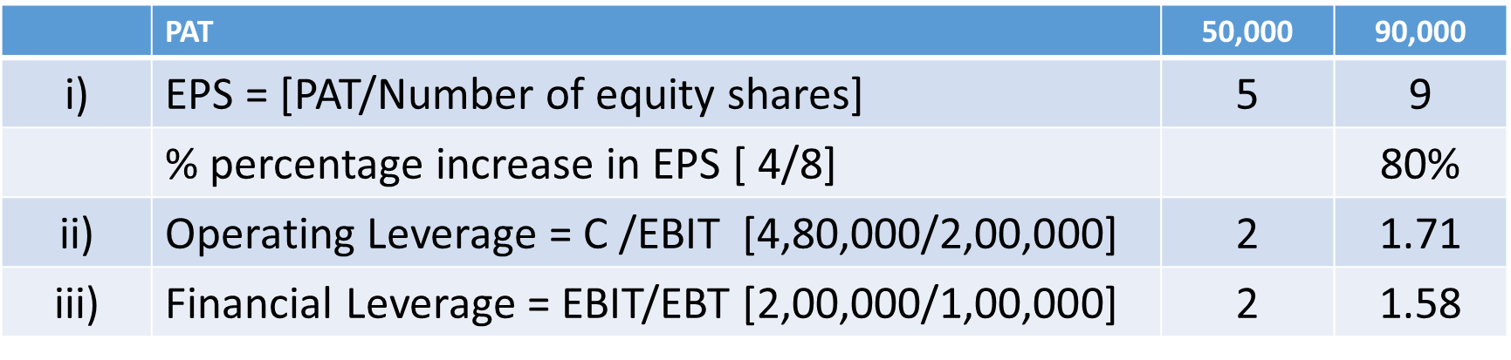
On account of increase in sales from 1 lakh units to 1,20,000 units @ Rs. 10 per unit, EPS increase by 80% while operating leverage down from 2 to 1.71 and financial leverage decline from 2 to 1.58. There is a significant decrease in both the business and financial risk of the company on account of reduction in both the leverages. This is generally the result when there is increase in sales without any increase in fixed operating or financial cost.

Slide 38
P8. A firm has sales of Rs. 75,00,000, variable cost of Rs. 42,00,000 and fixed cost of Rs. 6,00,000. It has debt of Rs. 45,00,000 at 9% and equity of Rs. 55,00,000.
What is the firms ROI?
Does it have favourable financial leverage?
If the firm belongs to an industry whose asset turnover is 3, does it have a high or low asset leverage?
What are the operating and financial and combined leverages of the firm?
If the sales drop to Rs. 50,00,000. what will be the new EBIT?
At what level the EBT of the firm will be equal to zero?

Slide 39
P9. XYZ and Co. has three financial plans before it, Plan I, Plan II and Plan III. Calculate operating and financial leverage for the firm on the basis of the following information and also find out the highest and lowest value of combined leverage :
Production 800 Units
Selling Price per unit Rs. 15
Variable cost per unit Rs. 10
Fixed Cost : Situation A = Rs. 1,000
Situation B = Rs. 2,000
Situation C = Rs. 3,000
Capital Structure | Plan I | Plan II | Plan III
Equity Capital [Rs.] | 5,000 | 7,500 | 2,500
12% Debt [Rs.] | 5,000 | 2,500 | 7,500

Slide 40
Solution: Statement showing operating leverage
 | Particulars | Situation A | Situation B | Situation C
 | Number of unis sold | 800 | 800 | 800
 |  | Rs. | Rs. | Rs.
 | Sales [Rs. 800 × Rs. 15] | 12,000 | 12,000 | 12,000
Less | Variable cost @ Rs. 10 per unit | 8,000 | 8,000 | 8,000
 | Contribution | 4,000 | 4,000 | 4,000
Less | Fixed cost | 1,000 | 2,000 | 3,000
 | EBIT | 3,000 | 2,000 | 1,000
 | Operating leverage = Contribution/EBIT | 1.33 | 2 | 4

Slide 41
Statement showing financial leverage
 |  | Plan I | Plan II | Plan III
Situation A:
 | EBIT | 3,000 | 3,000 | 3,000
Less | Interest @12 % of debt | 600 | 300 | 900
 | EBT | 2,400 | 2,700 | 2,100
 | Financial Leverage = EBIT/EBT | 1.25 | 1.11 | 1.43
Situation B:
 | EBIT | 2,000 | 2,000 | 2,000
Less | Interest @ 12% of debt | 600 | 300 | 900
 | EBT | 1,400 | 1,700 | 1,100
 | Financial Leverage = EBIT/EBT | 1.43 | 1.18 | 1.82
Situation C:
 | EBIT | 1,000 | 1,000 | 1,000
Less | Interest @ 12% of debt | 600 | 300 | 900
 | EBT | 400 | 700 | 100
 | Financial Leverage = EBIT/EBT | 2.50 | 1.43 | 10

Slide 42
Calculation of Combined Leverage:
The combined leverage may be calculated by multiplying the operating leverage and financial leverage for different combination of Situation A, B & C and the Financial Plans, I, II & III as follows:
The calculation of combined leverage shows the extent of the total risk and is helpful to understand the variability of EPS as a consequence of change in sales levels. In this case, the highest combined leverages is there when financial plan III is implemented in situation C; and lowest value of combined leverage is attained when financial Plan II is implemented in situation A.
Financial Plan | Situation A | Situation B | Situation C
I | 1.66 | 2.86 | 10
II | 1.47 | 2.36 | 5.72
III | 1.90 | 3.64 | 40

Slide 43
P10. The following data is available for XYZ Ltd.:
 | Particulars | Rs.
 | Sales | 2,00,000
Less | Variable cost @30% | 60,000
 | Contribution | 1,40,000
Less | Fixed Cost | 1,00,000
 | EBIT | 40,000
Less | Interest | 5,000
 | Profit before tax [EBT] | 35,000

Slide 44
Find out:
Using the concept of financial leverage, by what percentage will the taxable income increase if EBIT increase by 6%.
(ii) Using the concept of operating leverage, by what percentage will EBIT increase if there is 10% increase in sales, and
(iii) Using the concept of leverage, by what percentage will the taxable income increase if the sales increase by 6%. Also verify results in view of the above figures.

Slide 45
Solution:
(i) Degree of financial leverage:
DFL = EBIT/Profit before Tax [EBT] = 40,000/35,000 = 1.15
If EBIT increase by 6%, the taxable income will increase by 1.15 × 6 = 6.9% and it may be verified as follows:
 | Particulars | Rs.
 | EBIT (after 6% increase) | 42,400
Less | Interest | 5,000
 | Profit before Tax [EBT] | 37,400
Increase in taxable income is Rs. 2,400 i.e., 6.9% of Rs. 35,000

Slide 46
(ii) Degree of operating leverage:
DOL = Contribution/EBIT = 1,40,000/40,000 = 3.50
If Sales increase by 10%, the EBIT will increase by 3.50 × 10 = 35% and it may be verified as follows:
 | Particulars | Rs.
 | Sales (after 10% increase) | 2,20,000
Less | Variable Expenses @30% | 66,000
 | Contribution | 1,54,000
Less | Fixed cost | 1,00,000
 | EBIT | 54,000
Increase in EBIT is Rs. 14,000, i.e., 35% of Rs. 40,000.

Slide 47
(iii) Degree of combined leverage:
DCL = Contribution/Profit before Tax = 1,40,000/35,000 = 4
If Sales increases by 6%, the profit before tax will increase by 4 × 6 = 24% and it may be verified as follows:
 | Particulars | Rs.
 | Sales (after 6% increase) | 2,12,000
Less | Variable Expenses @ 30% | 63,600
 | Contribution | 1,48,400
Less | Fixed cost | 1,00,000
 | EBIT | 48,400
 | Interest | 5,000
 | Profit before Tax | 43,400
Increase in Profit before tax is Rs. 8,400 i.e., 24% of Rs. 35,000.

Slide 48
P11. Ascertain financial leverage from the information given below:
Net worth: Rs.20,00,000
Debt/Equity ratio: 3:1
Interest rate = 10%
Operating profit = Rs.18,00,000

Slide 49
Solution:
Net worth [Debt + Equity] = Rs. 20,00,000
Debt/Equity Ratio = 3:1, [Debt = 3/4 and Equity = 1/4]
Therefore, Debt = Rs. 20,00,000 × 3/4 = Rs. 15,00,000
Equity = Rs. 20,00,000 × 1/4 = Rs. 5,00,000
Rate of interest = 10% on debt
Interest = Rs. 15,00,000×10/100 = Rs. 1,50,000

Slide 50
Calculation of Financial Leverage:
 | Particulars | Rs.
 | EBIT | 18,00,000
Less | Interest | 1,50,000
 | EBT | 16,50,000
 | Financial Leverage = EBIT/EBT = 18,00,000/16,50,000 | 1.09 Times

Slide 51
P12.From the following prepare Income Statement of Company A, B and C. Briefly comment on each company’s performance.
Particulars | A | B | C
Financial Leverage | 3:1 | 4:1 | 2:1
Interest | Rs. 200 | Rs. 300 | Rs.1,000
Operating Leverage | 4:1 | 5:1 | 3:1
Variable cost as a % to sales | 66.67% | 75% | 50%
Income Tax Rate | 45% | 45% | 45%

Slide 52
Income Statement of Companies
 | Particulars | A (Rs.) | B (Rs.) | C (Rs.)
 | Sales | 3,600 | 8,000 | 12,000
Less | Variable cost | 2,400 | 6,000 | 6,000
 | Contribution | 1,200 | 2,000 | 6,000
Less | Fixed cost [C – EBIT] | 900 | 1600 | 4,000
 | EBIT or OP | 300 | 400 | 2,000
Less | Interest on debts [Given] | 200 | 300 | 1,000
 | Earnings before tax [EBT] | 100 | 100 | 1,000
Less | Income tax | 45 | 45 | 450
 | Profit after tax [PAT] | 55 | 55 | 550

Slide 53
P13. The Hardware Company has to make a choice between debt issue for its expansion programmes. Its current position is as follows:
 | Particulars | Rs.
 | Debt 5% | 20,000
 | Equity capital ( Rs. 10 Per share) | 50,000
 | Surplus | 30,000
 | Total Capitalization | 1,00,000
 | Sales | 3,00,000
Less | Total costs | 2,69,000
 | Earnings before interest and tax [EBIT] | 31,000
Less | Interest | 1,000
 | Income before tax [EBT] | 30,000
 | Income tax @50% | 15,000
 | Income after tax [PAT] | 15,000

Slide 54
The expansion programme is estimated to cost Rs. 50,000. If this is financed through debt, the rate of new debt will be 7% and the price earning ratio will be 6 times. If the expansion programme is financed through the equity shares, the new shares can be sold netting of Rs. 25 per share and the profit earning ratio will be 7 times. The expansion will generate additional sales of Rs. 1,50,000 with the return of 10% on sales before interest and taxes.
If the company is to follow the policy of maximising the market value of the shares, which firm of financing would be choose?

Slide 55
Thank You

